Slide 1


SHELL-LPG Swift An Online Cylinder Booking System
Presented By :
Priyanshu Tiwari
Naman Mittal
Atishi Jain
Shivang Dubey
Priti Sah

Slide 2
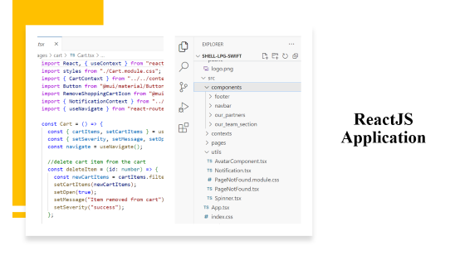
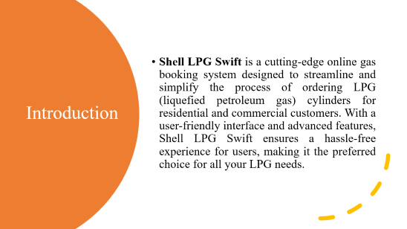
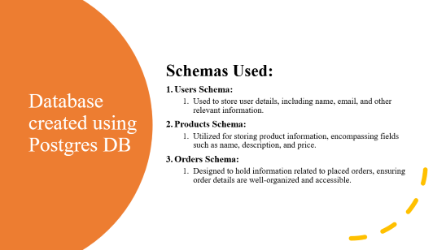

Slide 3
Introduction
Shell LPG Swift is a cutting-edge online gas booking system designed to streamline and simplify the process of ordering LPG (liquefied petroleum gas) cylinders for residential and commercial customers. With a user-friendly interface and advanced features, Shell LPG Swift ensures a hassle-free experience for users, making it the preferred choice for all your LPG needs.

Slide 4
Key Features
User Friendly
Seamless Registration
Quick Cylinder Booking
Payment and Order Confirmation
Authentication using JWT

Slide 5
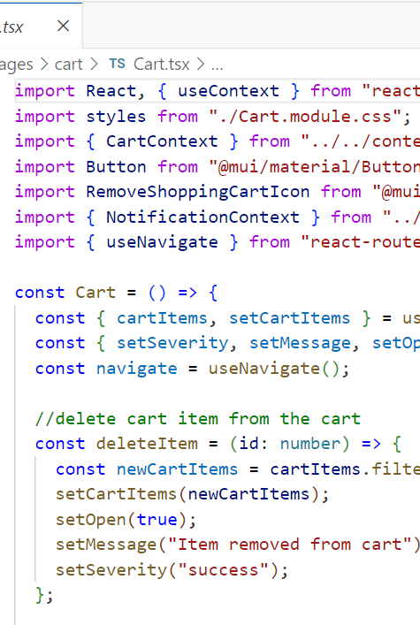
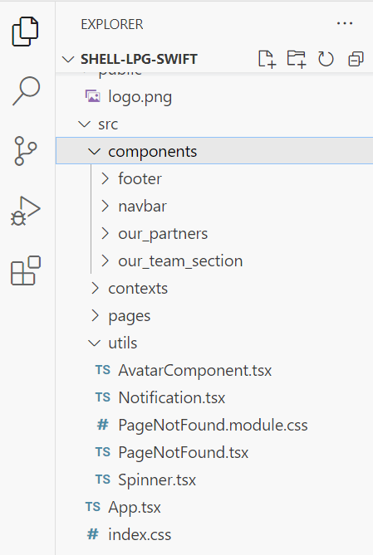
ReactJS Application

Slide 6
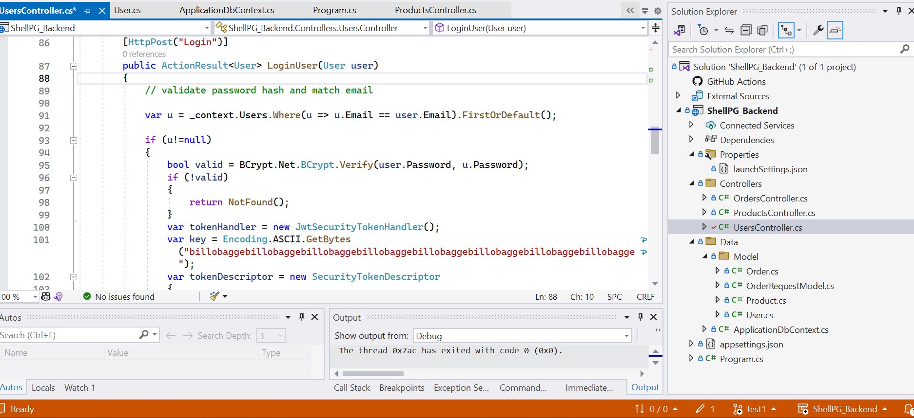
Authentication

Slide 7
Security Authentication
Password Criteria:
For security purposes, we have implemented a password creation policy that requires users to create passwords with-
Minimum length of 6 characters
Atleast 1 uppercase character
Atleast 1 lowercase character
Atleast 1 special character
Atleast 1 numeric character
Wrong Password Dialogue Box:
In the event of an incorrect password entry, users will encounter a "Wrong Password" dialogue box, which provides feedback on the login attempt. This dialogue box is designed to alert users when their password does not meet the specified criteria or if there is a login error.

Slide 8
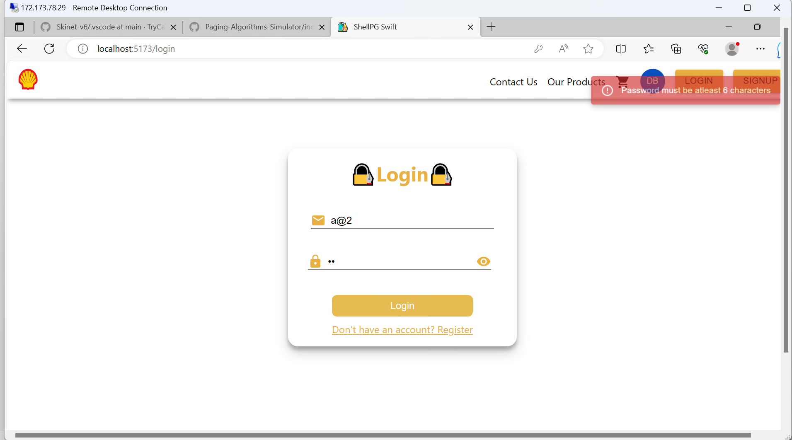
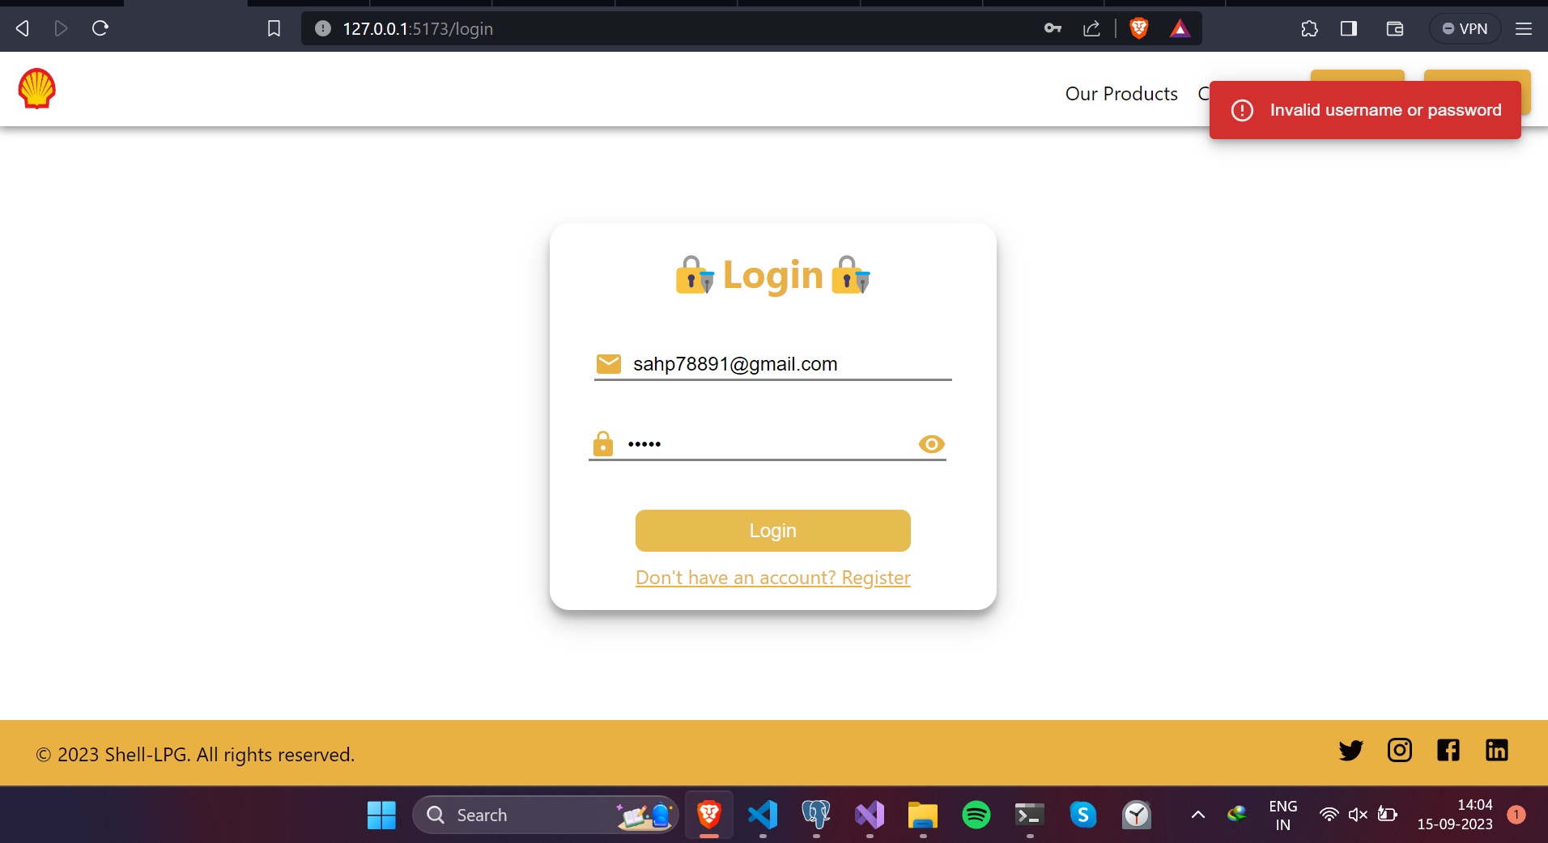

Slide 9
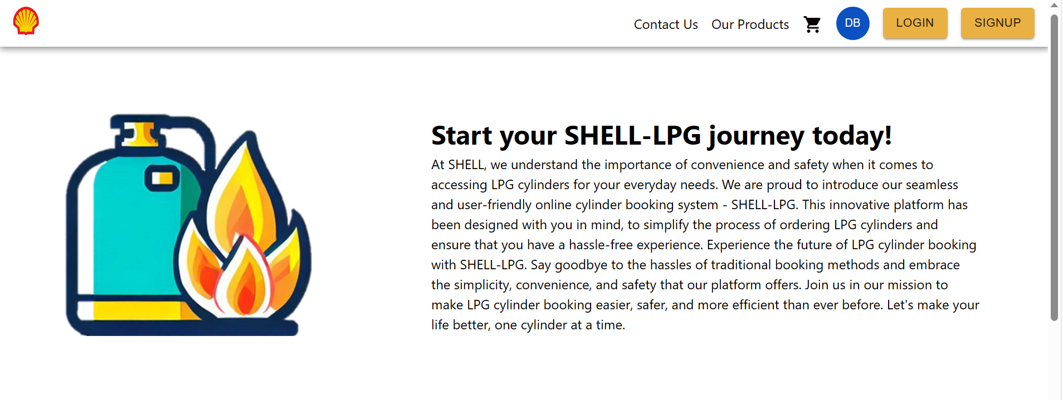

Home Page
A glimpse of our “Home Page” where a customer can login or sign up on our website .
He/She can get to know about our team and about our partners.

Slide 10
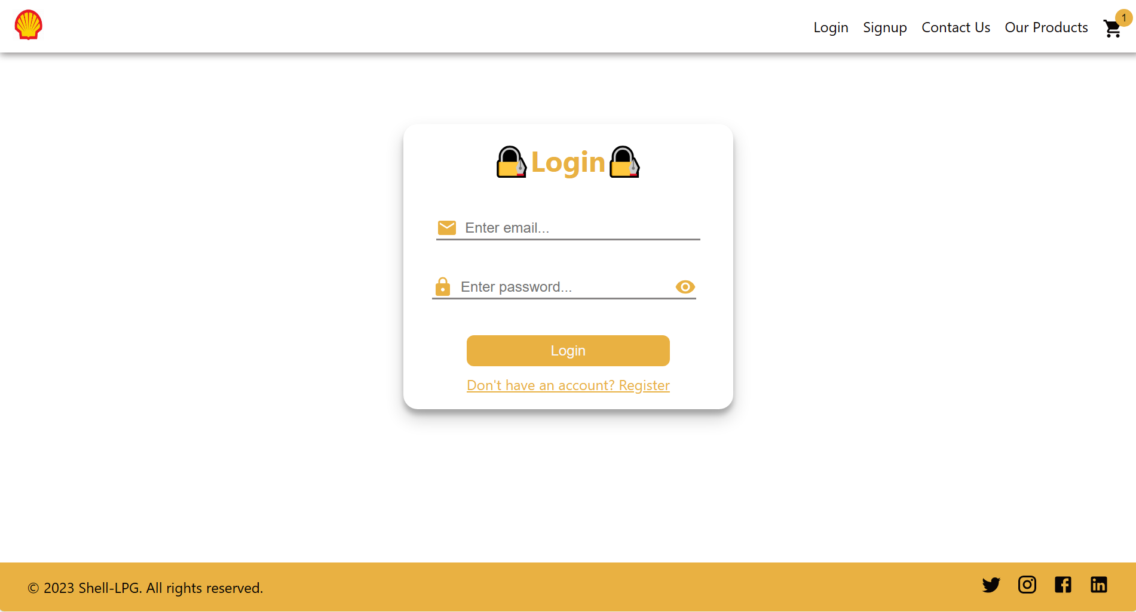
Login Page

Slide 11
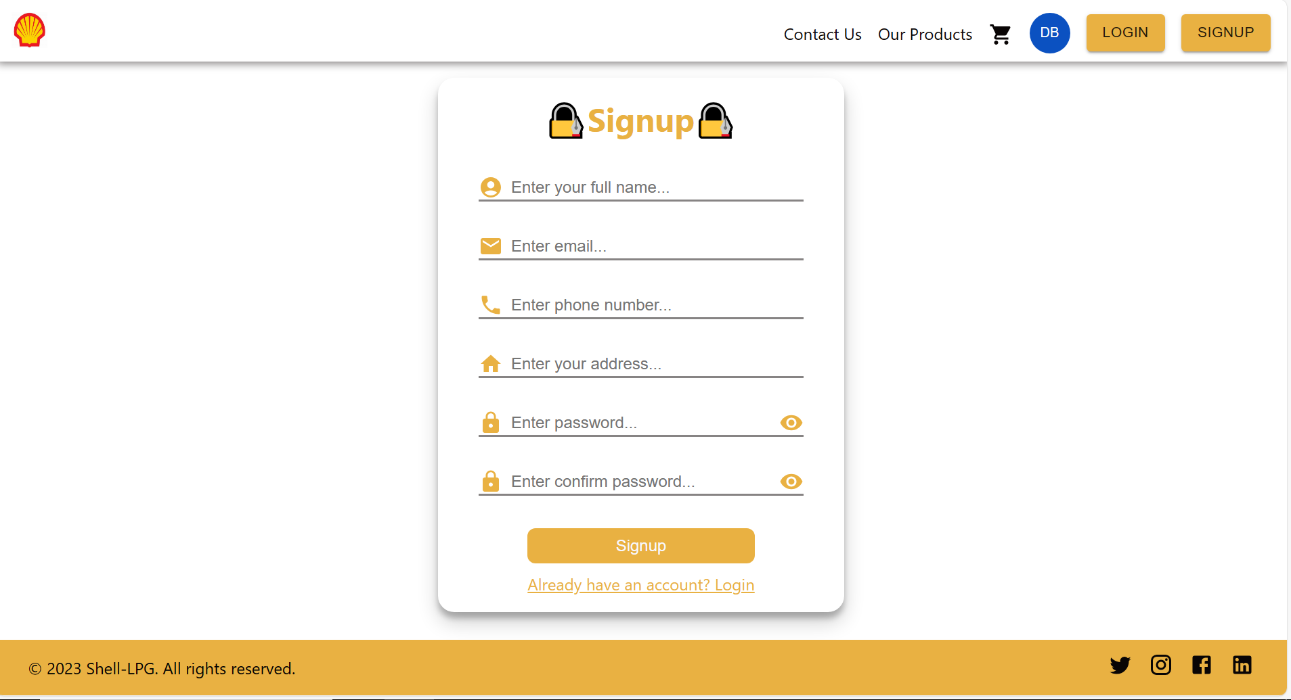

Sign Up Page

Slide 12
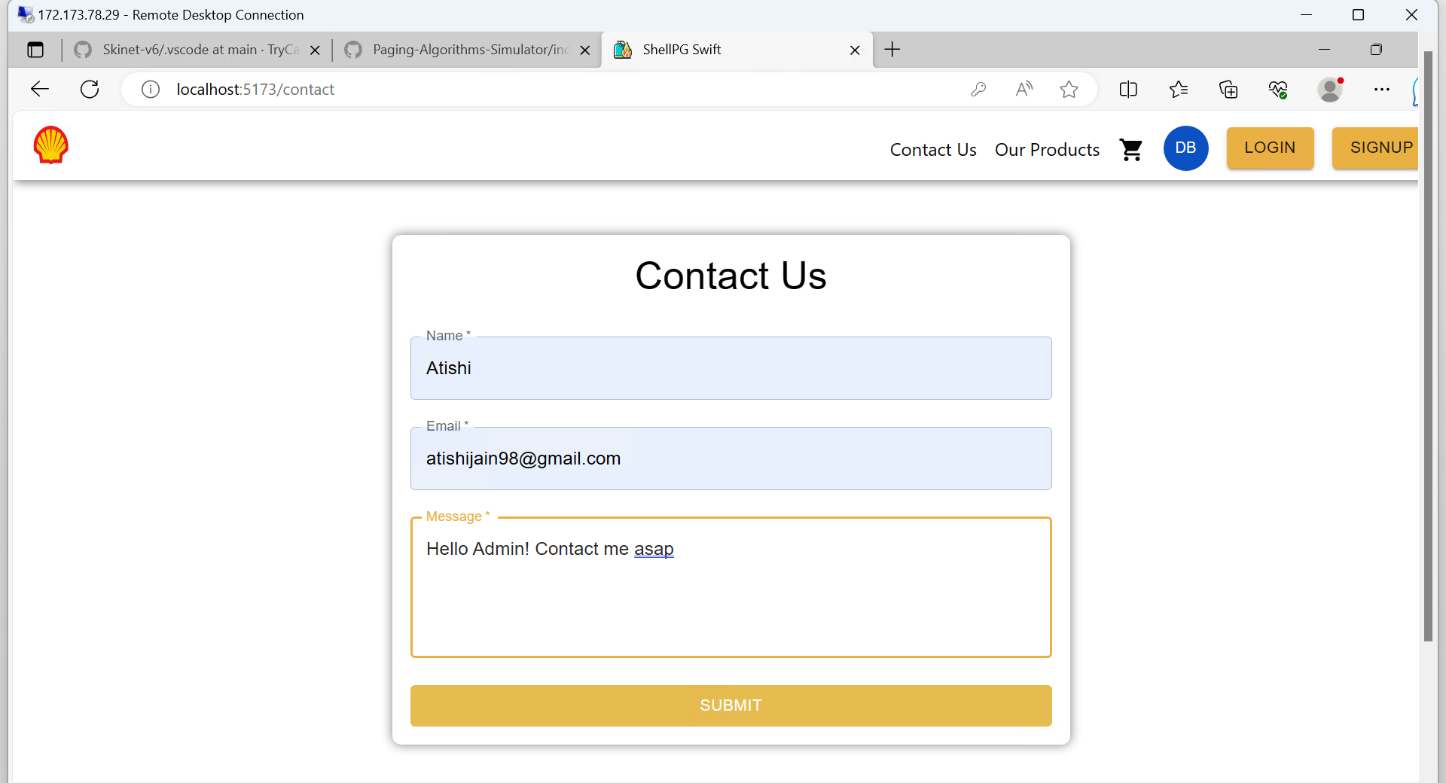
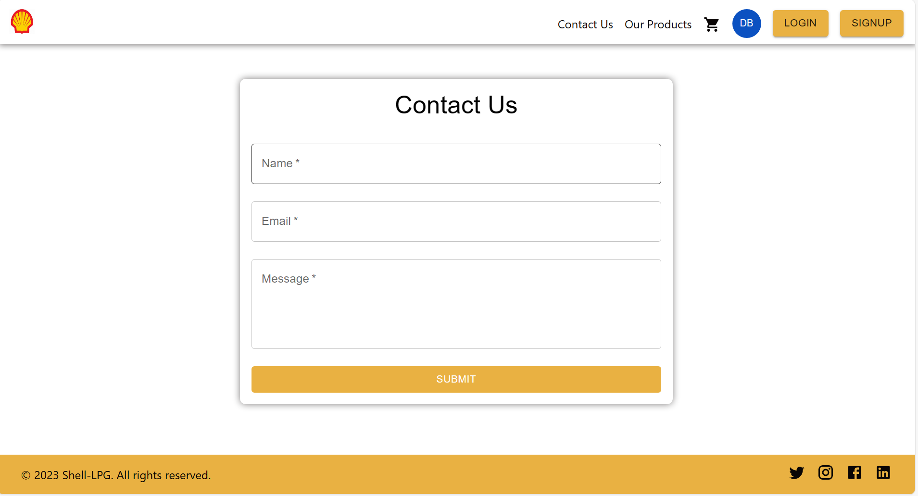
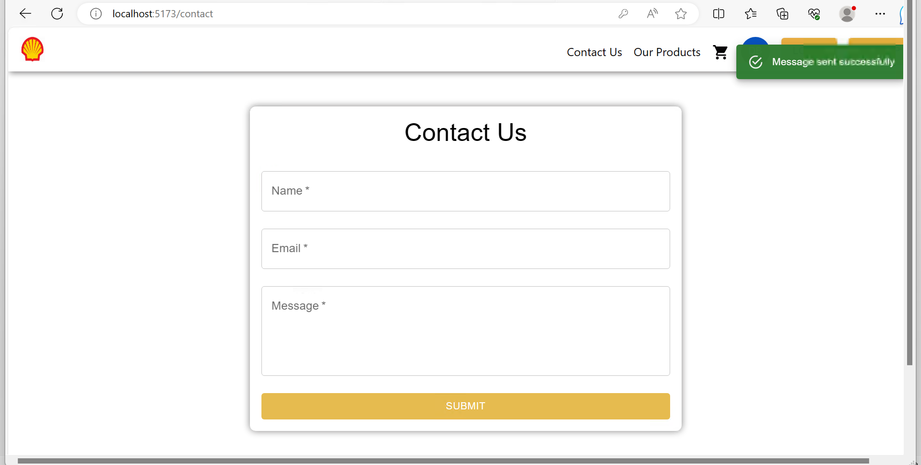
Contact Us

Slide 13
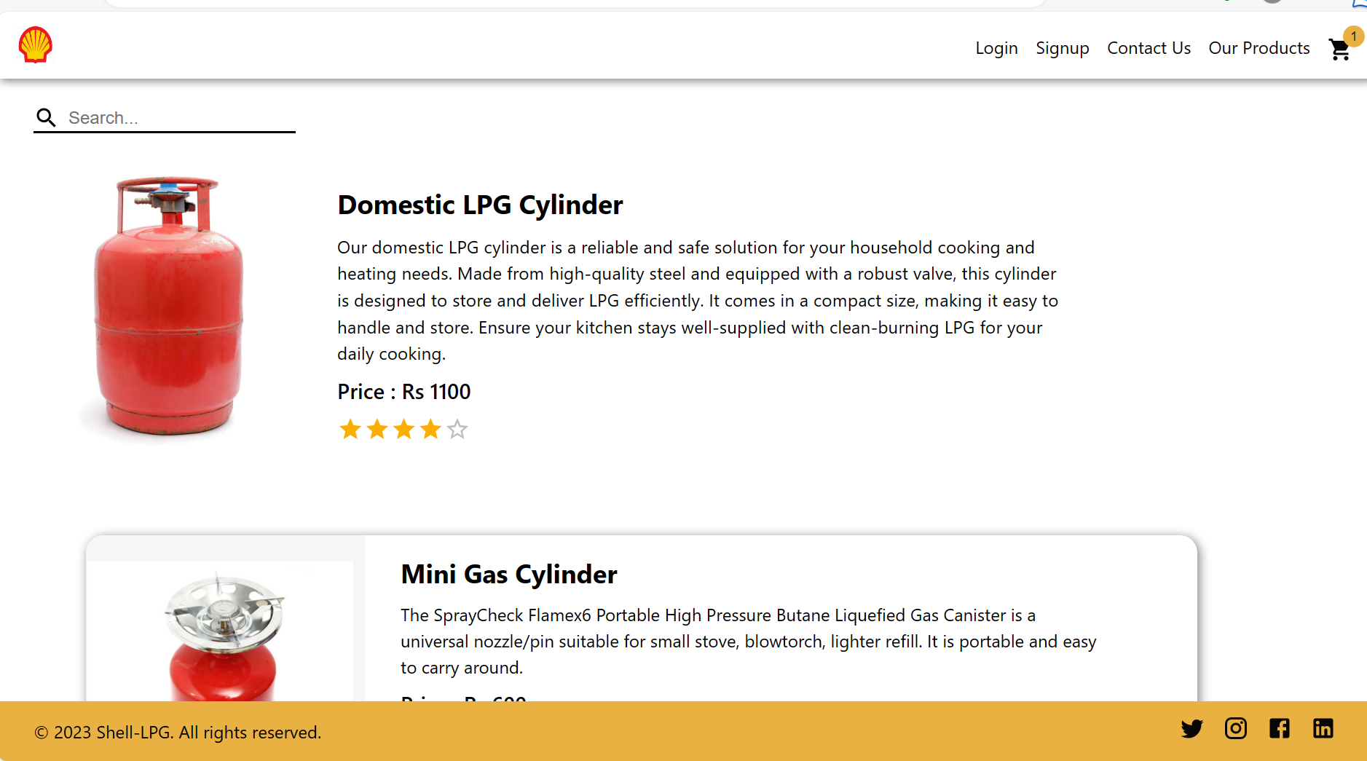
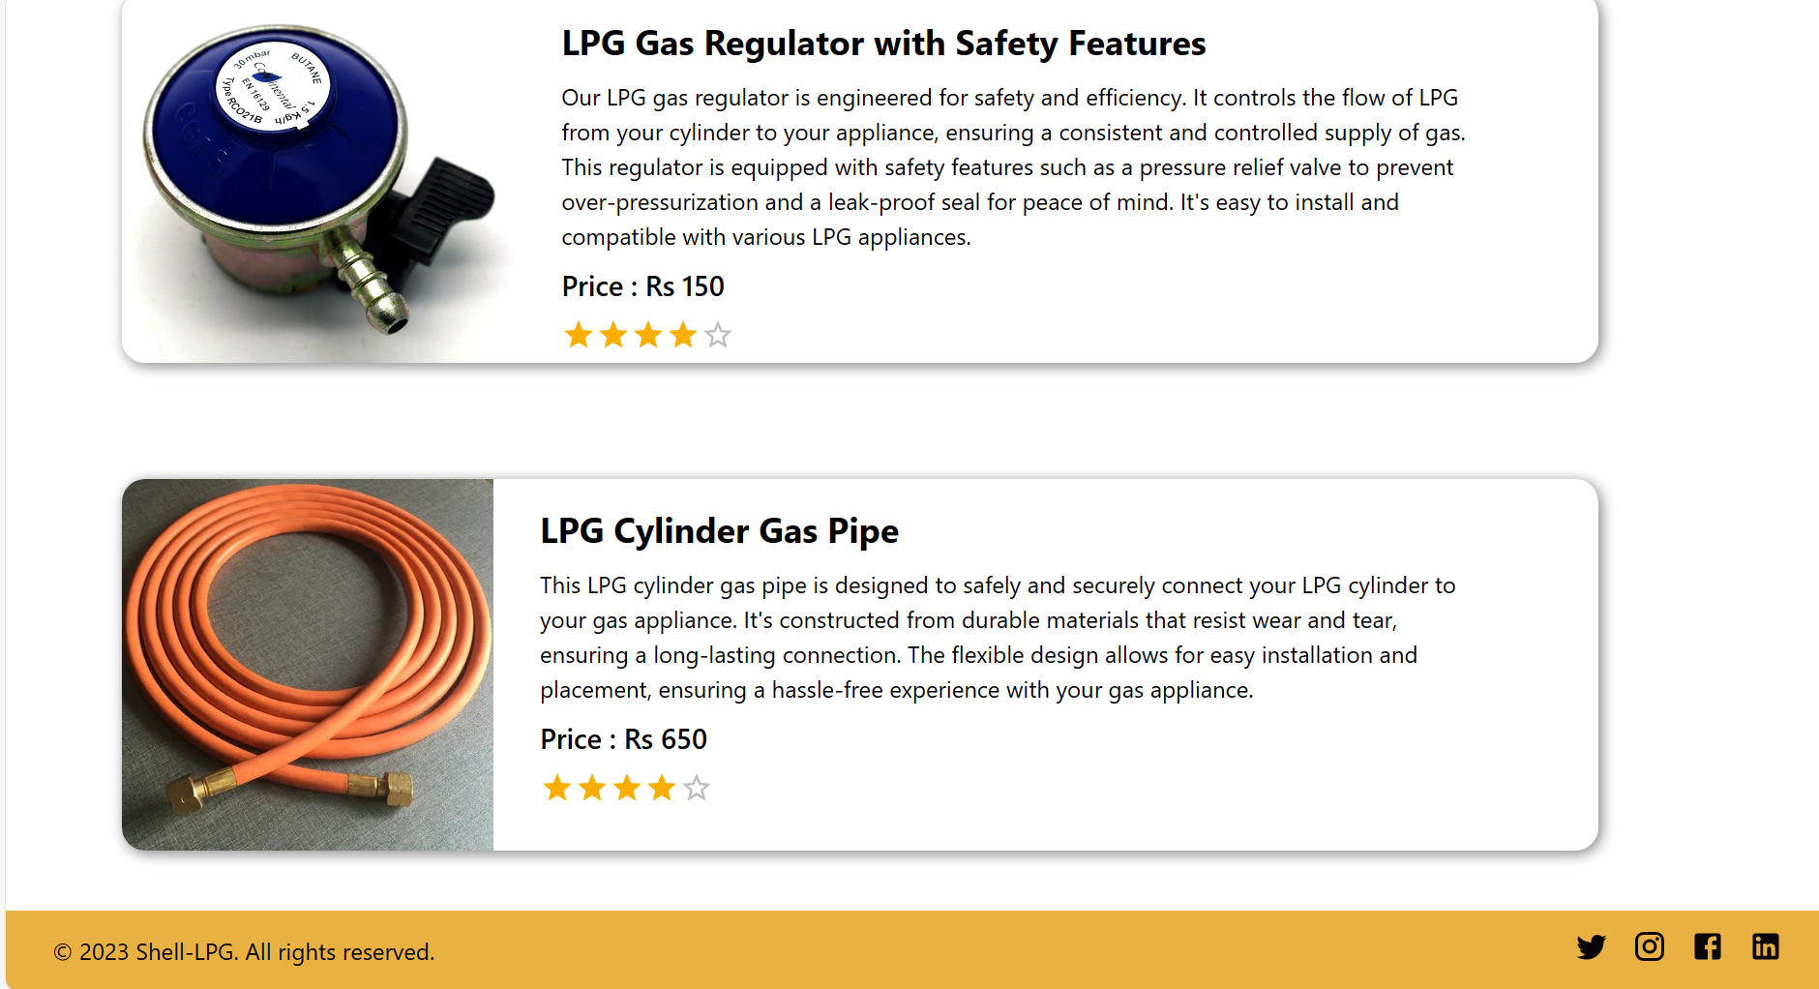
Our Products

Slide 14
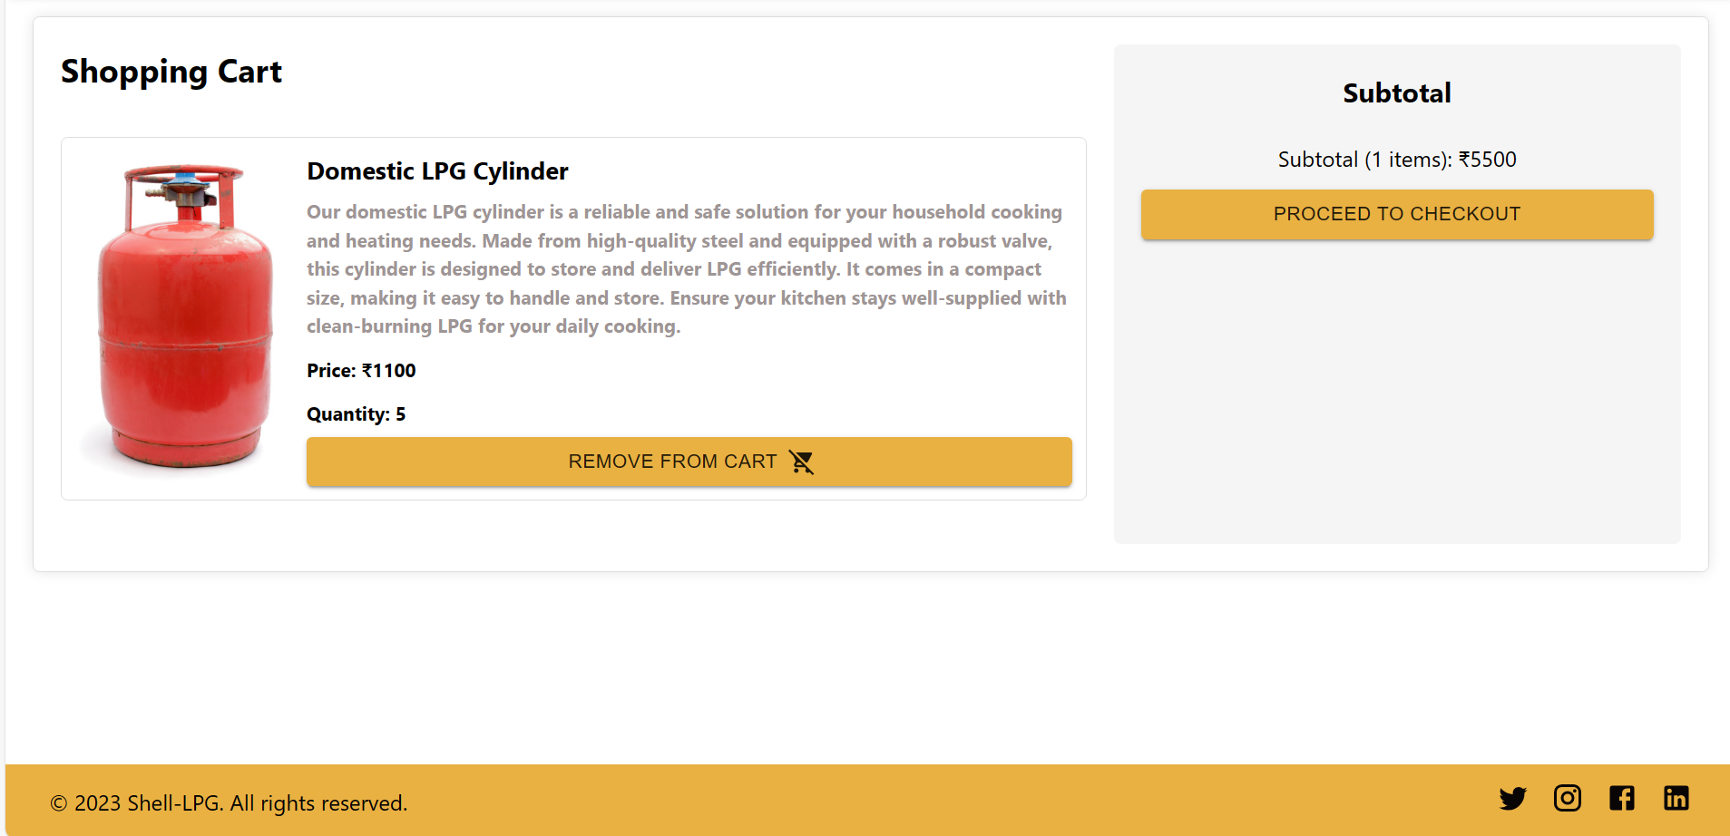
Cart

Slide 15
Database created using Postgres DB
Schemas Used:
Users Schema:
Used to store user details, including name, email, and other relevant information.
Products Schema:
Utilized for storing product information, encompassing fields such as name, description, and price.
Orders Schema:
Designed to hold information related to placed orders, ensuring order details are well-organized and accessible.

Slide 16
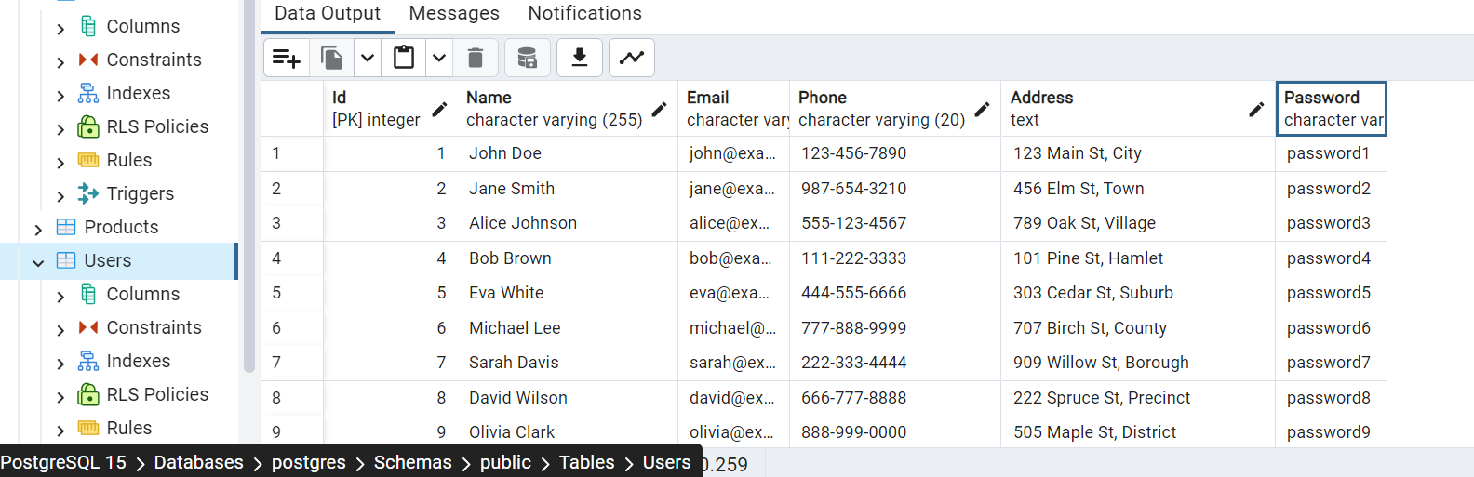
Users Table

Slide 17
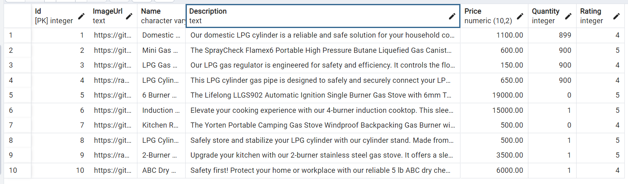
Products Table

Slide 18
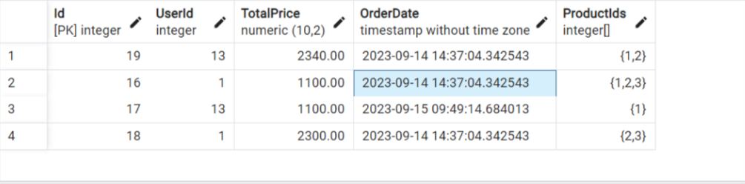
Orders Table

